Slide 1


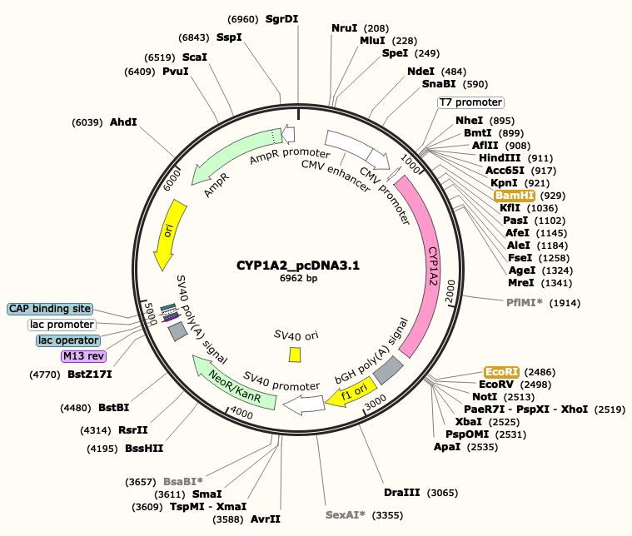
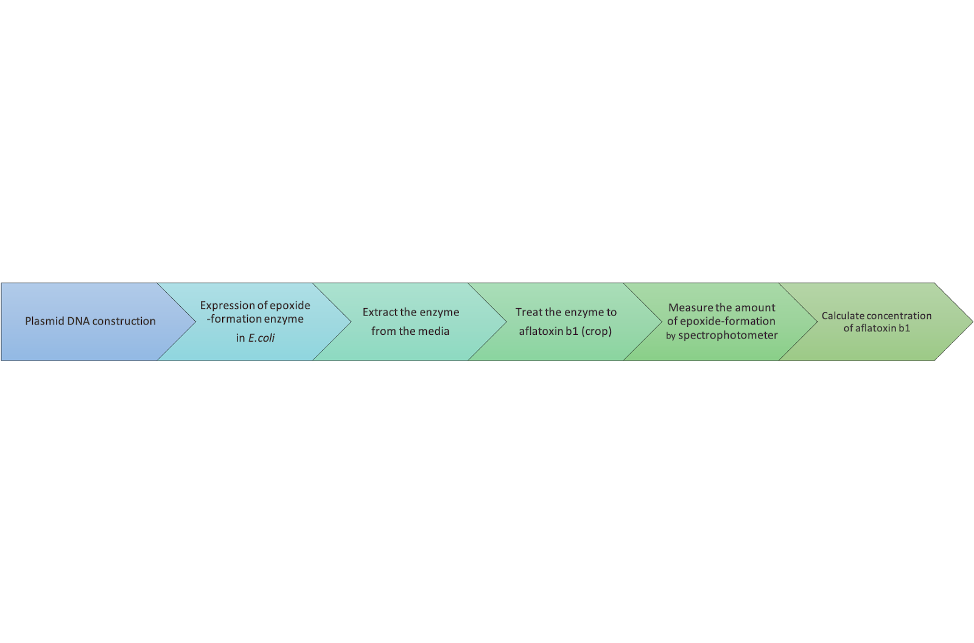
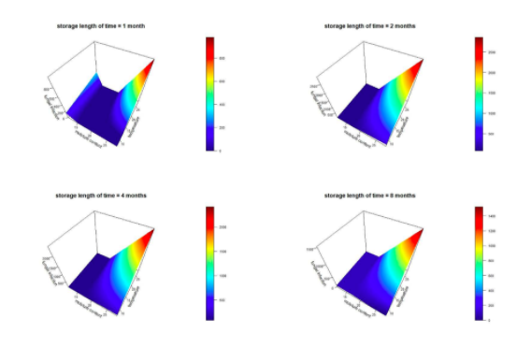
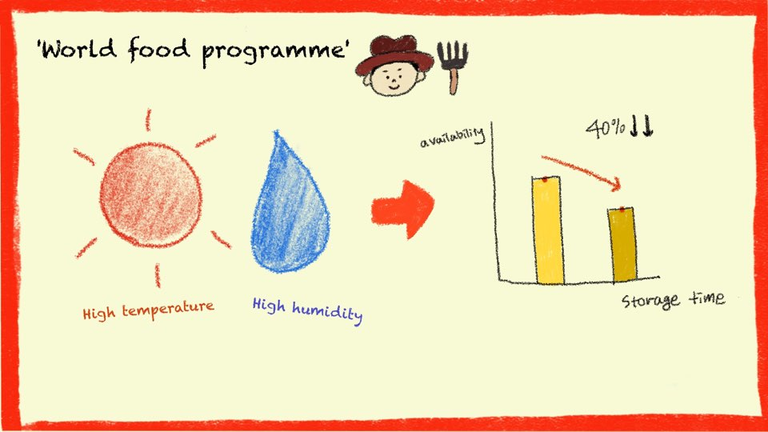
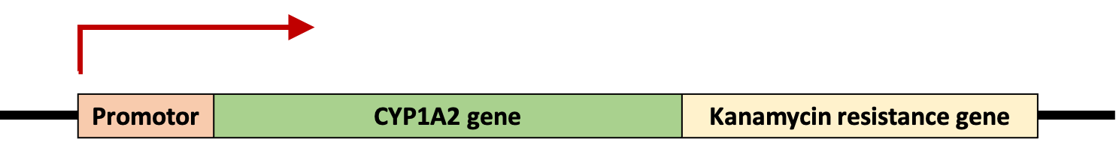
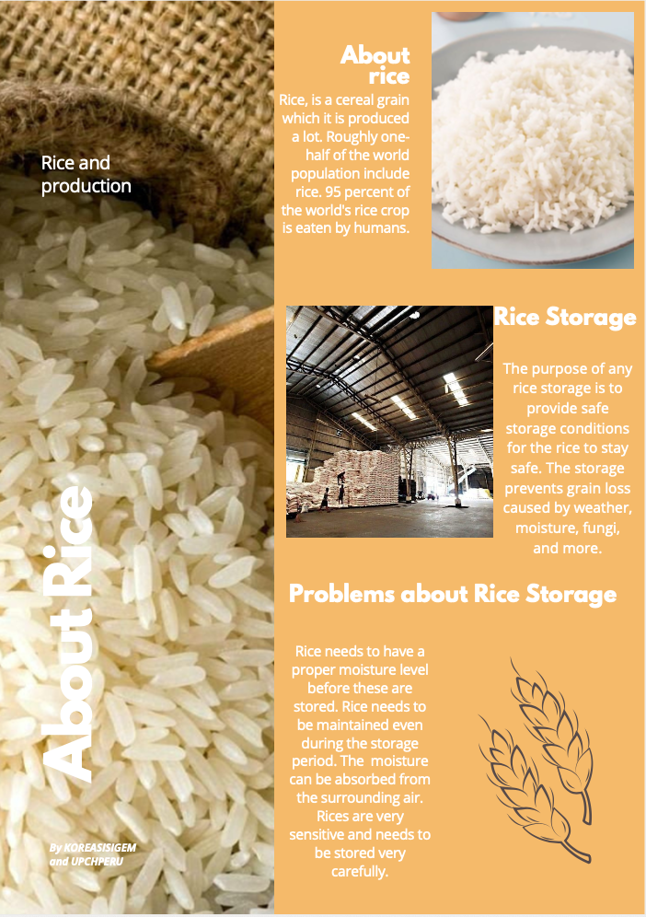
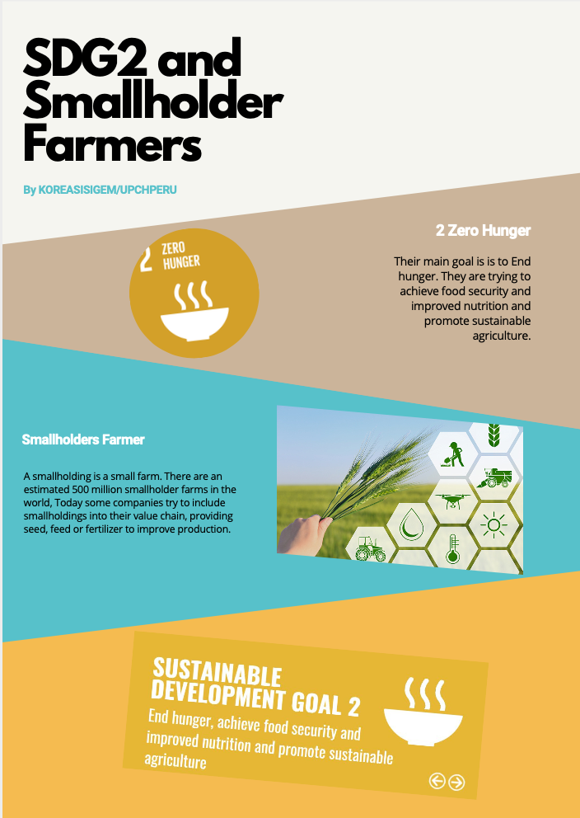
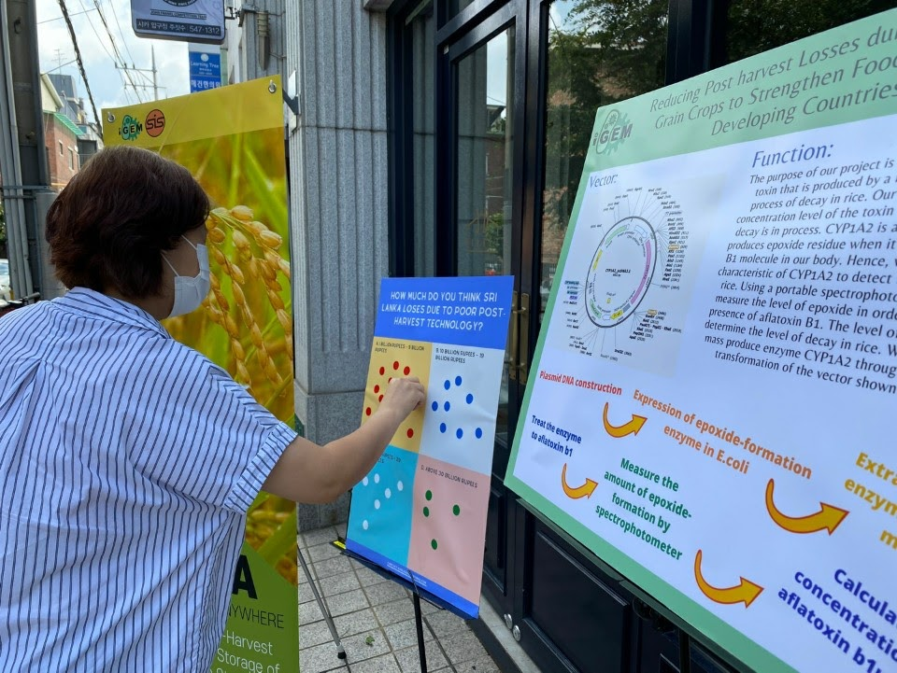


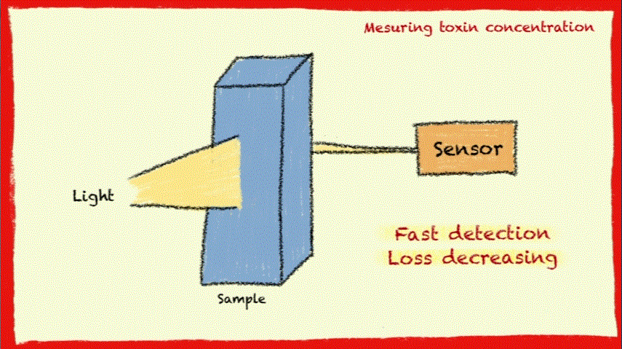

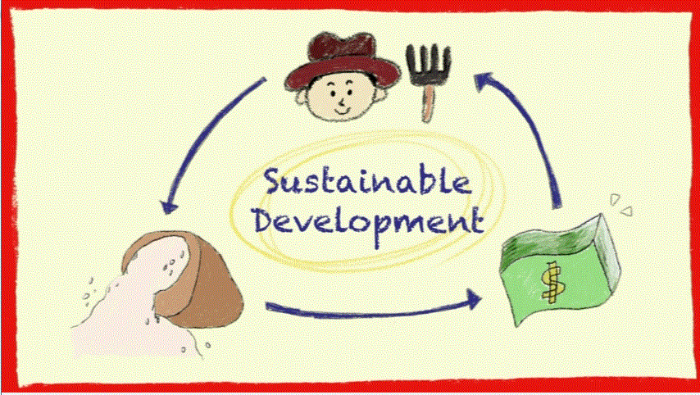

Poster Presented by: Team KOREA-SIS 2020
SAVE OUR RICE ANYWHERE: Synthetic Biology for Reduce Loss of Rice in Postharvest process
- To engineer a system that will detect the levels of toxins in the rice storage.
- To create this system, we will mass produce Escherichia coli to produce the CYP1A2 enzyme.
- To mainly combat the issue of post harvest losses.
The absence of a systemic storage system of rice was the most critical complication, which is why we seeked a potential solution through the iGEM project.
This is not only relevant in Sri Lanka, but also in other developing countries, as rice is a major staple food, which exemplifies the urgent need to implement an effective post harvest system.
PROJECT GOALS
ENGINEERING
Method of Promotion
ENGINEERING
Workflow
ENGINEERING
Modeling
MOTIVATION
- We designed recombinant E.coli which express CYP1A2 human enzyme that is required for toxin detection.
- We proposed a nonparametric MARS model designed to capture possible inter-dependent effects of environmental factors on fungal infection of stored rice.
- We will make this system to have more efficiency and widely-used.
- Not only commercialization but also spreading widely with NGOs is what we want to do with this idea.
COMMUNICATE
Human Practices
Education
Interviews
Campaigns
Surveys
PROPOSED IMPLEMETATION
CURRENT AND FUTURE WORK
ACCESIBLITY
WET LAB EXPERIMENT
REAL APPLICATION
COLLABORATIONS AND ATTRIBUTIONS

Slide 2
Poster Presented by: Team KOREA-SIS 2020
SAVE OUR RICE ANYWHERE: Synthetic Biology for Reduce Loss of Rice in Postharvest process
- To engineer a system that will detect the levels of toxins in the rice storage.
- To create this system, we will mass produce Escherichia coli to produce the CYP1A2 enzyme.
- To mainly combat the issue of post harvest losses.
PROJECT GOALS
ENGINEERING:
Method of Promotion
ENGINEERING:
Workflow
ENGINEERING:
Modeling
MOTIVATION
COMMUNICATE
The absence of a systemic storage system of rice was the most critical complication, which is why we seeked a potential solution through the iGEM project.
This is not only relevant in Sri Lanka, but also in other developing countries, as rice is a major staple food, which exemplifies the urgent need to implement an effective post harvest system.
Human Practices
Education
Interviews
Campaigns
Surveys
PROPOSED IMPLEMETATION
CURRENT AND FUTURE WORK
- We designed recombinant E.coli which express CYP1A2 human enzyme that is required for toxin detection.
- We proposed a nonparametric MARS model designed to capture possible inter-dependent effects of environmental factors on fungal infection of stored rice.
- We will make this system to have more efficiency and widely-used.
- Not only commercialization but also spreading widely with NGOs is what we want to do with this idea.
ACCESIBLITY
WET LAB EXPERIMENT
REAL APPLICATION
COLLABORATIONS AND ATTRIBUTIONS

Slide 3
Poster Presented by: Team KOREA-SIS 2020
SAVE OUR RICE ANYWHERE: Synthetic Biology for Reduce Loss of Rice in Postharvest process
- To engineer a system that will detect the levels of toxins in the rice storage.
- To create this system, we will mass produce Escherichia coli to produce the CYP1A2 enzyme.
- To mainly combat the issue of post harvest losses.
PROJECT GOALS
MOTIVATION
ENGINEERING:
Method of Promotion
ENGINEERING:
Workflow
The absence of a systemic storage system of rice was the most critical complication, which is why we seeked a potential solution through the iGEM project.
This is not only relevant in Sri Lanka, but also in other developing countries, as rice is a major staple food, which exemplifies the urgent need to implement an effective post harvest system.
ENGINEERING:
Modeling
COMMUNICATE
Human Practices
Education
Interviews
Campaigns
Surveys
PROPOSED IMPLEMETATION
CURRENT AND FUTURE WORK
- We designed recombinant E.coli which express CYP1A2 human enzyme that is required for toxin detection.
- We proposed a nonparametric MARS model designed to capture possible inter-dependent effects of environmental factors on fungal infection of stored rice.
- We will make this system to have more efficiency and widely-used.
- Not only commercialization but also spreading widely with NGOs is what we want to do with this idea.
ACCESIBLITY
WET LAB EXPERIMENT
REAL APPLICATION
COLLABORATIONS AND ATTRIBUTIONS

Slide 4
Poster Presented by: Team KOREA-SIS 2020
SAVE OUR RICE ANYWHERE: Synthetic Biology for Reduce Loss of Rice in Postharvest process
PROPOSED IMPLEMETATION
CURRENT AND FUTURE WORK
- We designed recombinant E.coli which express CYP1A2 human enzyme that is required for toxin detection.
- We proposed a nonparametric MARS model designed to capture possible inter-dependent effects of environmental factors on fungal infection of stored rice.
- We will make this system to have more efficiency and widely-used.
- Not only commercialization but also spreading widely with NGOs is what we want to do with this idea.
REAL APPLICATION
COLLABORATIONS AND ATTRIBUTIONS

Slide 5
- To engineer a system that will detect the levels of toxins in the rice storage.
- To create this system, we will mass produce Escherichia coli to produce the CYP1A2 enzyme.
- To mainly combat the issue of post harvest losses.
PROJECT GOALS
ENGINEERING:
Modeling
COMMUNICATE
Human Practices
Education
Interviews
Campaigns
Surveys
PROPOSED IMPLEMETATION
CURRENT AND FUTURE WORK
- We designed recombinant E.coli which express CYP1A2 human enzyme that is required for toxin detection.
- We proposed a nonparametric MARS model designed to capture possible inter-dependent effects of environmental factors on fungal infection of stored rice.
- We will make this system to have more efficiency and widely-used.
- Not only commercialization but also spreading widely with NGOs is what we want to do with this idea.
ACCESIBLITY
WET LAB EXPERIMENT
REAL APPLICATION
COLLABORATIONS AND ATTRIBUTIONS

Slide 6
1)
SAVE OUR RICE ANYWHERE: Synthetic Biology for Reduce Loss of Rice in Postharvest process
Presented by Team SIS-KOREA 2020 Clara Yim¹, Jinha Kim¹, Brian Cho¹, Hanjoo Lee¹, Ian Kim¹, Taejoo Lee¹, Myungjin Shin¹, Sarah Yim¹, Jaeeun Kil², Semyung Shin² Dr. Rose Tyvand³ ¹iGEM Student Team Member, ²iGEM Team Mentor, ³iGEM Team Primary PI, Seoul International School, Seoul, Republic of Korea
Abstract
Rice is a staple food for many countries in Asia. Rice needs to be dried and stored under specific conditions after harvest. If not, it loses its merchantability and affects the total yield. In Sri Lanka, it affects the livelihood of 1.8 million farmers and the lack of proper post-harvest technology is costing them 2393 million dollars annually. The fungi that are present in the storage of rice are Aspergillus spp. In this project, we establish a stringent post-harvest management system for rice by measuring the concentration of aflatoxin B1, a toxin produced by Aspergillus spp. To measure the concentration of AFB1, we used the enzyme, cytochrome P450 1A2. Reactions between AFB1 and CYP1A2 result in compounds with epoxide residue, which can be used for the detection. Here, we also proposed a nonparametric MARS model designed to capture possible inter-dependent effects of environmental factors on fungal infection of stored rice.

Slide 7
2)
Project Goals
To mainly combat the issue of post harvest losses, specifically in the process of storing the rice in Sri Lanka.
To Engineer a system that will detect the levels of toxins in the rice to control the quality and quantity of rice production.
- To create this system, we will mass produce Escherichia coli to produce the CYP1A2 enzyme.

Slide 8
3)
Motivation
According to the World Food Programme, a high percentage ranging from 14 to 35 percent in 25 districts suffer from acute malnutrition, elucidating the prevalent problem in the nation.
Within the post harvest system are post harvest losses that can not be overlooked, specifically the economic losses depicted by quantitative measurements.
We found out that the absence of a systemic storage system of rice was the most critical complication, which is why we seeked a potential solution through the iGEM project.
This is not only relevant in Sri Lanka, but also in other developing countries, as rice is a major staple food, which exemplifies the urgent need to implement an effective post harvest system.

Slide 9
4)
Engineering: Method of Promotion
To make the recombination E.coli that expresses CYP1A2, which is a human protein that we need for measuring the concentration of toxin, we had to design the CYP1A2 expression system. So we searched for an appropriate vector plasmid that has multiple cloning sites(MCS) and the antibiotics resistance gene(Here we have kanamycin resistance gene.) for our system. By using two restriction enzymes(Here we’re going to use EcoRI and and BamHI.) and two primers, recombinant vectors that carry the CYP1A2 gene can be constructed. Then, this vector plasmid has to be taken up to the E.coli cell, especially bacterial competent cells that have been specially treated to transform efficiently.

Slide 10
5)
Engineering: Workflow
To confirm whether the vectors with CYP1A2, our target gene are transferred to E.coli cells, the resistance gene that vectors have can be used. Our vectors have a kanamycin resistance gene, so kanamycin treated media will be used to get only E.coli cells which have vectors that are carrying the target gene.
After that, Recombinant E.coli will be grown in the 37C, and they will express CYP1A2 protein. Protein extraction process and protein purification can help to get the enzyme, without other molecules in the total cell lysate. And then, now we can use the enzyme to treat the crops, which have aflatoxins that should be measured by a spectrophotometer.
For protein purification, we are going to use His-tagged CYP1A2 gene.
< Main Experiment >
E.coli transformation → Protein extraction → Protein Purification

Slide 11
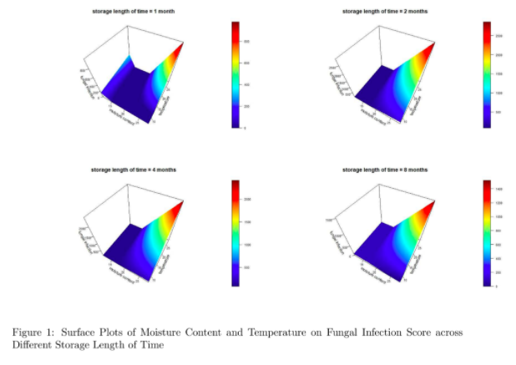
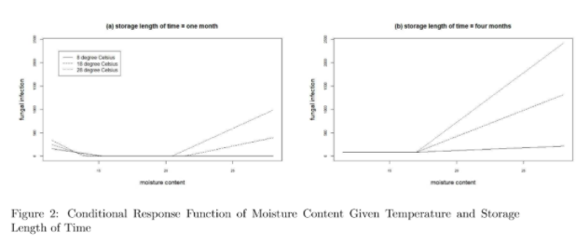
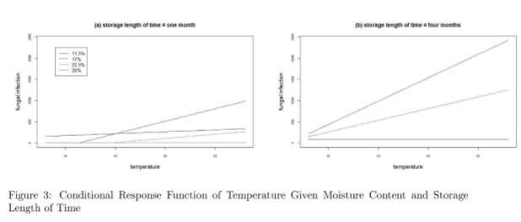
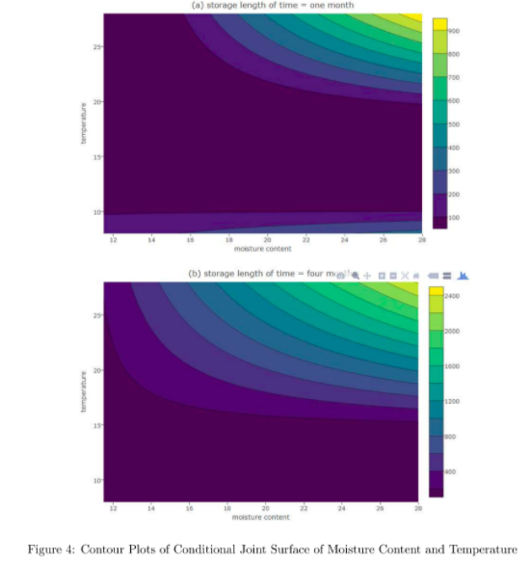
6)
Engineering: Modeling
we proposed a nonparametric MARS model designed to capture possible inter-dependent effects of environmental factors on fungal infection of stored rice.

Slide 12
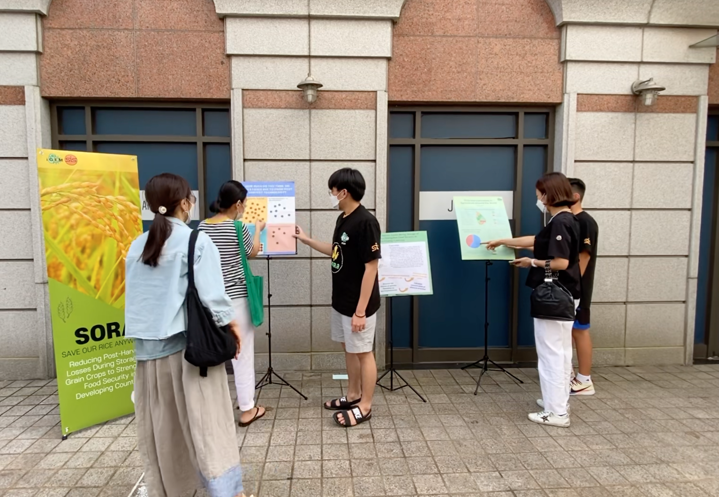
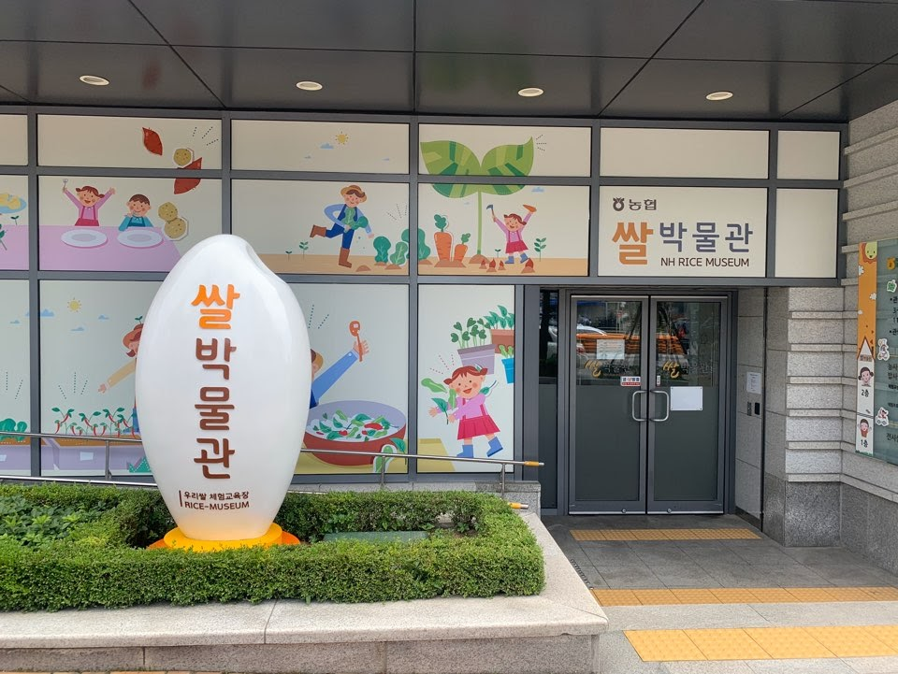
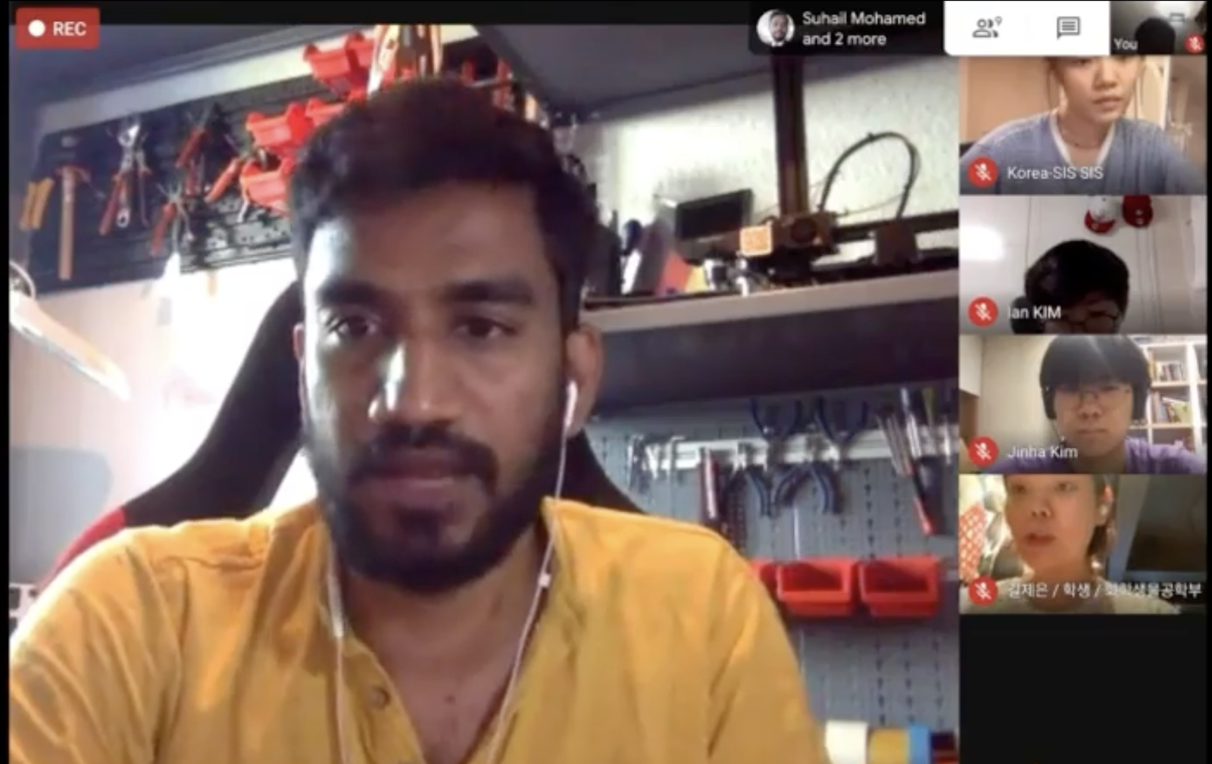
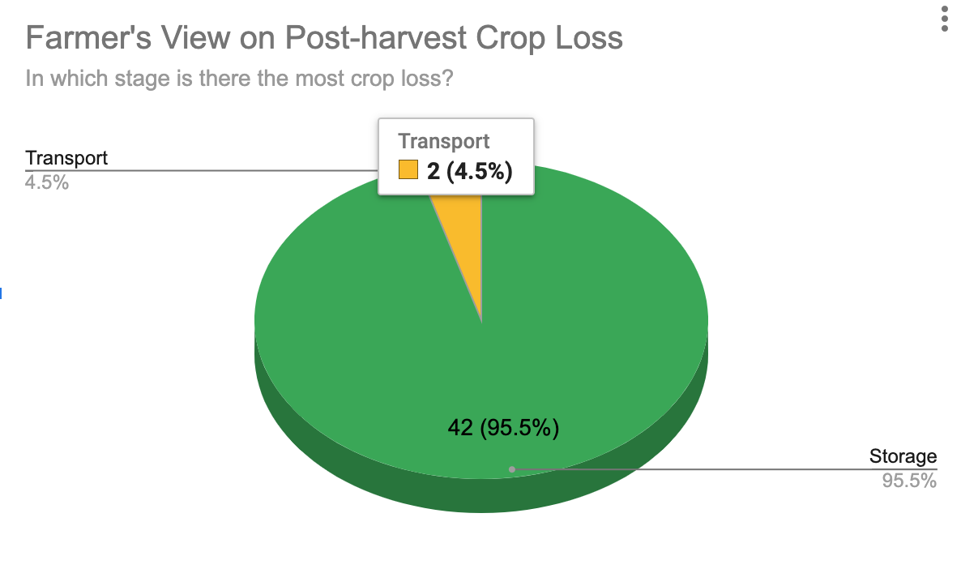
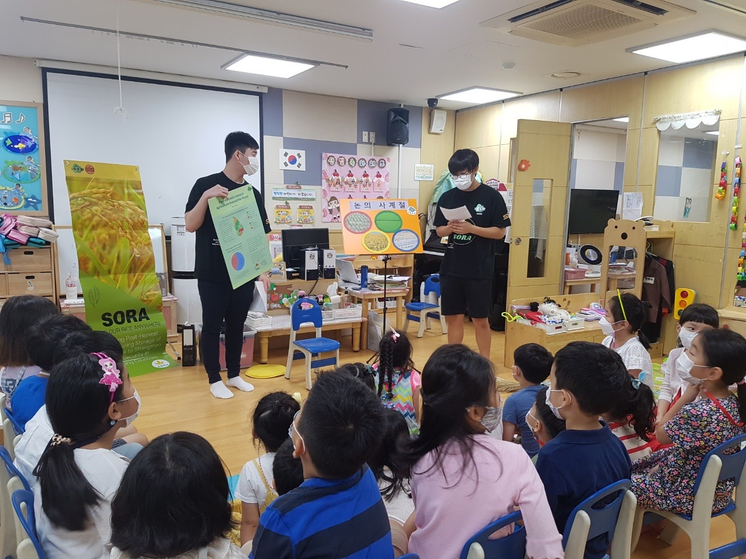
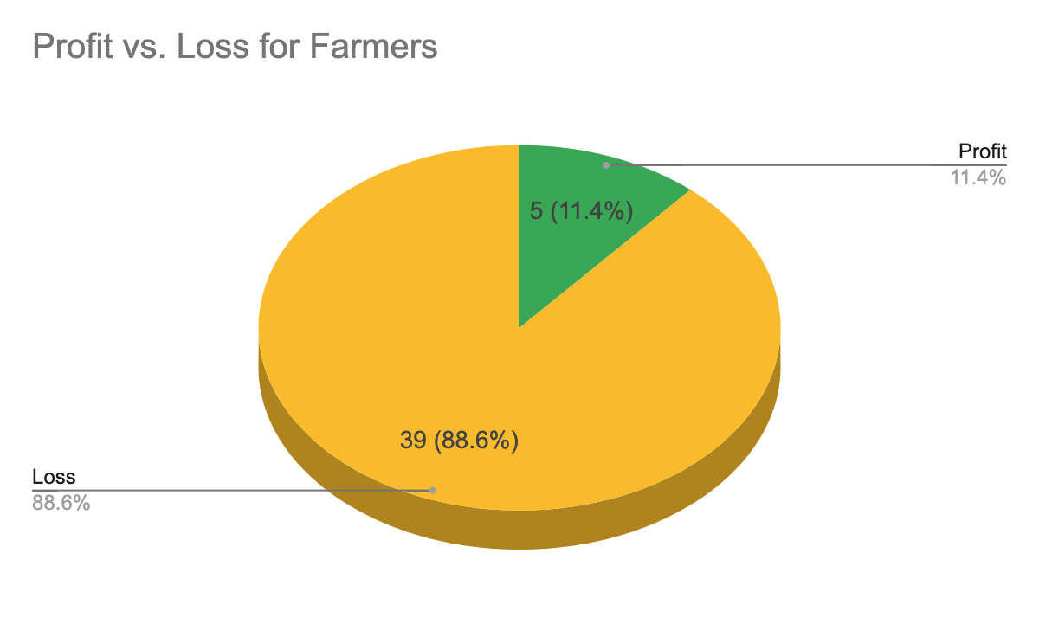
7)
COMMUNICATE
As much as it is important to establish a feasible and effective biological solution to address global issues, raising social awareness is vital to make actual positive change. Therefore, not only did we develop a biological design to reduce post-harvest losses in agricultural practices, but we also made efforts to increase awareness of this issue at hand. As our survey responses displayed, approximately 70% of people did not know the concept and issue of postharvest. Thus, our team decided it was our responsibility, through human practices, to gain important and accurate knowledge from professionals and experts and share the valuable information to the general public.

Slide 13
8)
PROPOSED IMPLEMENTATION
ACCESIBLITY - We would implement the project in the real world so that many people would be able to easily access our product.
WET LAB EXPERIMENT - Our experiments involve chemicals for bacterial transformation, immunoprecipitation, and western blotting. All of the safety measures related to these procedures are only basic lab protocols such as wearing gloves when handling chemicals and making sure to prevent any physical contact from occurring. Furthermore, since there is possible exposure to volatile liquids, dusts, and mists, we will use the clean bench and fume hood to prevent such exposure. We are not certified experts afterall in the lab; thus, we may make subtle mistakes that may endanger ourselves.
REAL APPLICATION - We need to consider the cost of our biosensor and E-coli and whether it is relatively inexpensive for real application. We need to formulate efficient yet cheap ways that will promote our product and enable it to be widely distributed around the world. Another challenge is teaching prospective users of our E-coli/biosensor on the specific details in using it.

Slide 14
9)
CURRENT AND FUTURE WORK
We designed recombinant E.coli which express CYP1A2 human enzyme that is required for toxin detection.
We proposed a nonparametric MARS model designed to capture possible inter-dependent effects of environmental factors on fungal infection of stored rice.
We will make this system to have more efficiency and widely-used.
Not only commercialization but also spreading widely with NGOs is what we want to do with this idea.

Slide 15
10)
COLLABORATIONS AND ATTRIBUTIONS
PI & Instructors
Dr. Rose Tyvand, Jae Eun Kil, Semyung Shin
Advisors
Dr. Jim Gerhard, Claudia Troncone, Dr. Jin Gyo Kim
Feedbacks
Jin Huh, Hae Il Ryu, Sang Woo Seo, DreamSpace Academy, Ross Bundy

